Slide 1

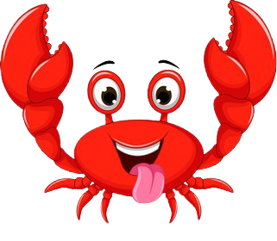
AI Practioner Project
Class: IBM IMVAI 1402
Team 2
Notes:
R U IN presentatin mode?

Slide 2

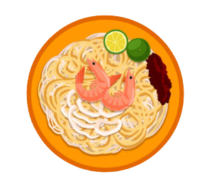
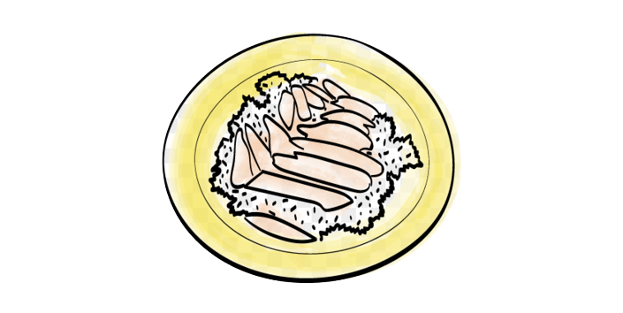
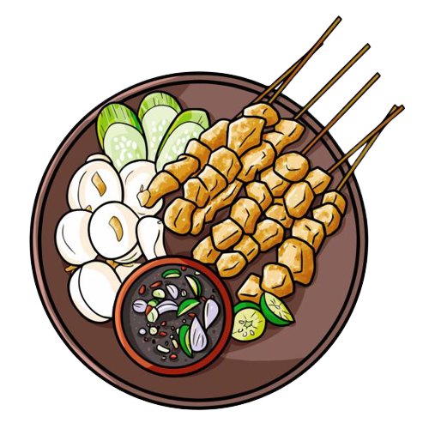
Makan Ventures
Lee Lee Sim
Wong Yoke Fuan
Saleem Jumabhoy
Tan Joo Hong
Sebastian Ang

Slide 3
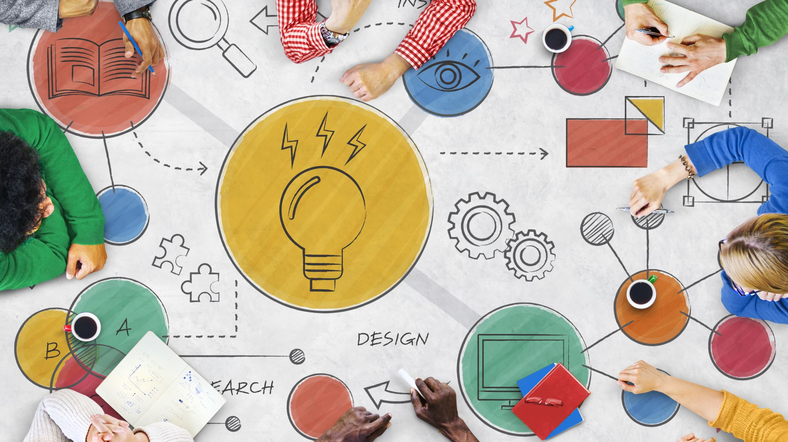

Agenda
Design Thinking Process
Implementation to Chatbot
AI Classification

Slide 4


Enterprise Design Thinking

Slide 5
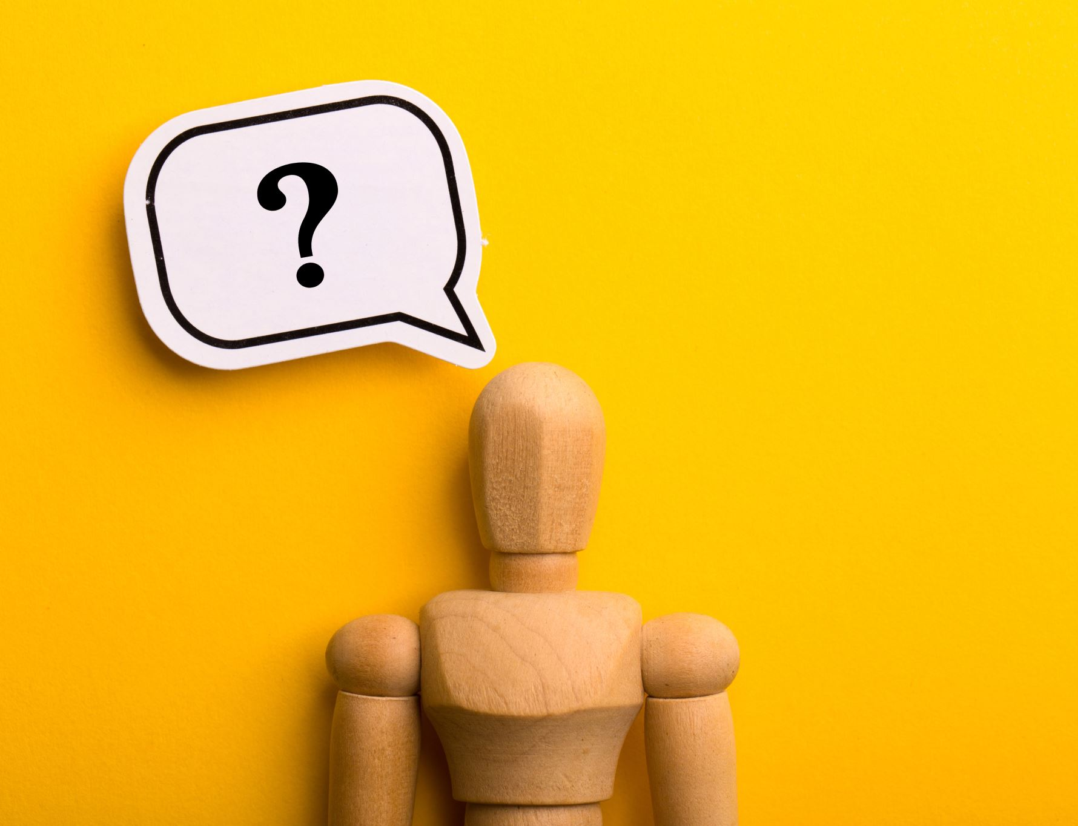
Problem Statement
How might we help to increase appreciation of our local hawker food culture for foreigners so that they can better appreciate local cuisine.

Slide 6
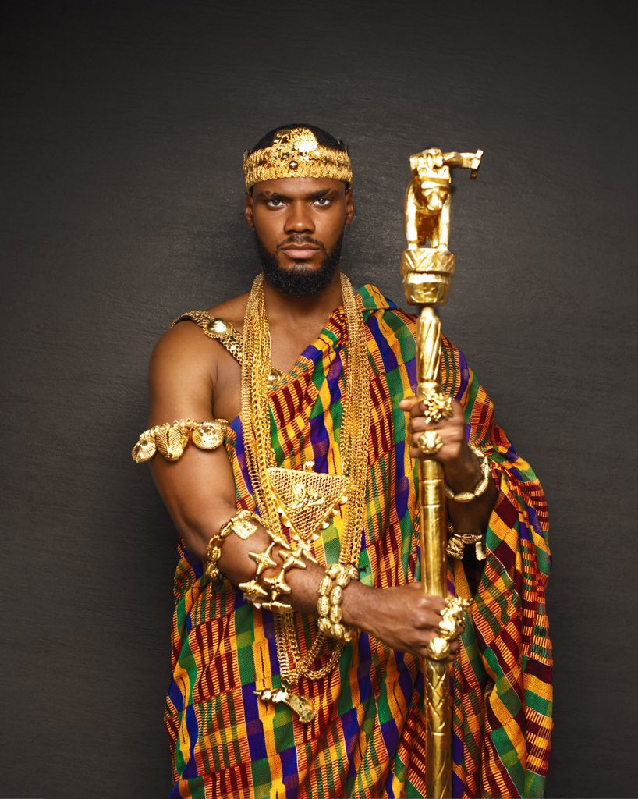

User Persona
Name: Prince Alubarugoo
From: Somalia
Age: 45
Occupation: Prince of Somalia
Family: Married, 20 wives, 42 children in 3 continents. Average age is 10.2 with 6.27 standard deviation
Net worth: $150M and trying to give it away to a Singaporean in Singapore
Status: First trip to Asia

Slide 7


Pain Points
Information is hard to understand "fish balls"
Wants specific information which is hard to find
Put information into context (time, ingredients, location)
Too many sites on Google wasting time

Slide 8

THE BIG IDEA
An online solution to help foreigners understand and quickly identify local food

Slide 9

AS-Is to TO-BE Scenario
AS-IS
Very fragmented and time-consuming process involving multiple websites, none with a complete "picture" of local hawker food
TO-BE
A seamless process with detailed information with responses to specific questions along with curated links.

Slide 10

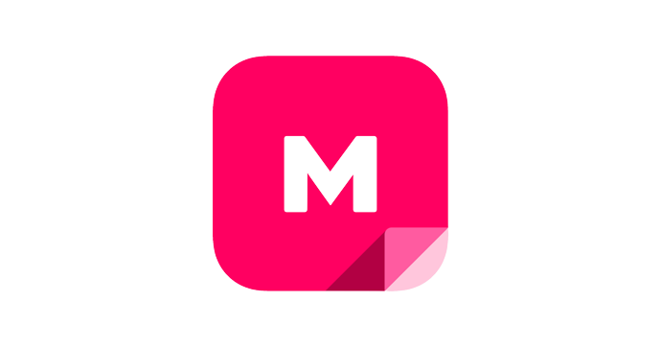


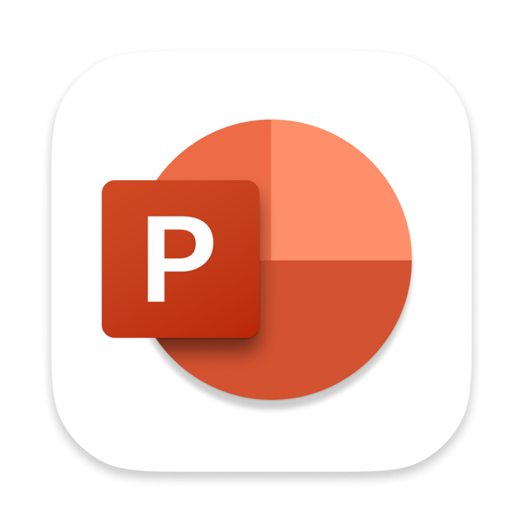




Tools Used
In order to deliver against the Big Idea, the team used a number of different tools:
Mural
PowerPoint
Watson Assistant
Github
Kaggle
HerokuApp
Jupyter Notebook
Flask
Tensorflow CPU

Slide 11
AI Design Essentials
Notes:
As we all know, since the introduction of internet, social media and cheaper data storage. There has been an exponential growth of available data. And with that, the development of more advanced algorithms are also made possible. The team seeks to help people and machine work together to create knowledge from all these available data. Now, let's take a look at the design essentials of the project.

Slide 12
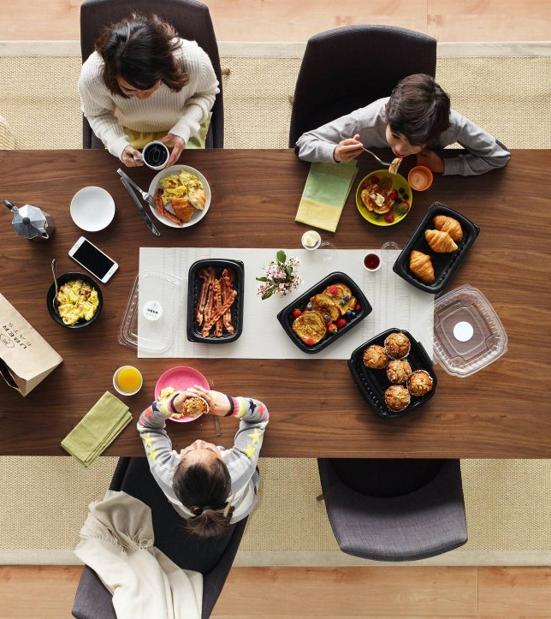
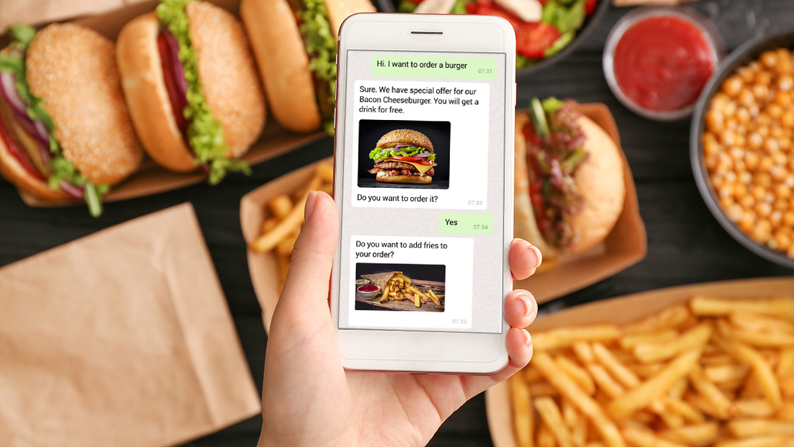
Design foundations
Purpose
To provide those unfamiliar with local food a better appreciation of our food culture. Once the AI can understand the user insights, it can be more helpful and faster in determining the intents of the users.
To create a "relationship" with foreigners, the solution has to be casual and informative.
Value
In the near future, the ability to order food through the bot and advertisement avenues could be financially interesting.
Notes:
The main objective of the team is to provide individuals especially foreigners a better appreciation of our local food cultures. Just like TikTok, the system will try to understands the users through their series of selections, so as to provide a customized experience for different users. Similar to Wikipedia, the tonality and language use would be causal and informative. This is to create a positive experience for our users and will be the first solution that comes to their mind when it comes to food.
The team is also looking forward to integrate food delivery and relevant advertisements for future developments.

Slide 13
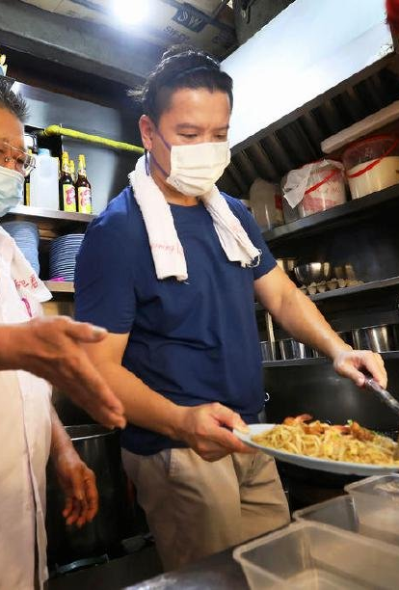

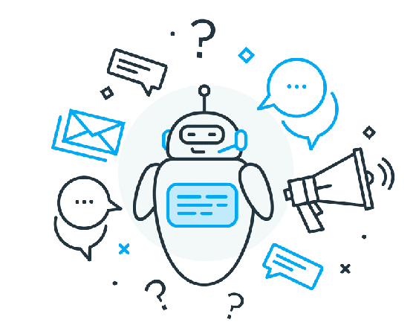
AI Intent
The goals, wants, needs, and values of users and alignment to the business. Intent provides your solution’s purpose.
As Singapore’s hawker culture is now nominated to UNESCO’s representative list, foreigners are not only looking to try the food, but also to understand and appreciate a little more about it.
With our AI Bot we seek to increase interactions and understanding of local foods for foreigners so that they can better appreciate Singapore's hawker culture.
Notes:
Singapore's Hawker Culture is a source of pride for Singapore and all Singaporeans. It reflects out living heritage and multiculturalism. With the launch of initiatives such as the Hawkers' Development Program (HDP) and the inscription of Singapore hawker culture into the UNESCO Representative List of the Intangible Cultural Heritage of Humanity. It is clear that the government is stepping up efforts in preserving local hawker food.
Our AI bot seeks to become the bridge between people and Singapore's hawker culture. It will help provide answers to the repetitive queries at any time of the day. This will be relevant to someone who is looking for information on Singapore food in their own local time in say Africa.

Slide 14
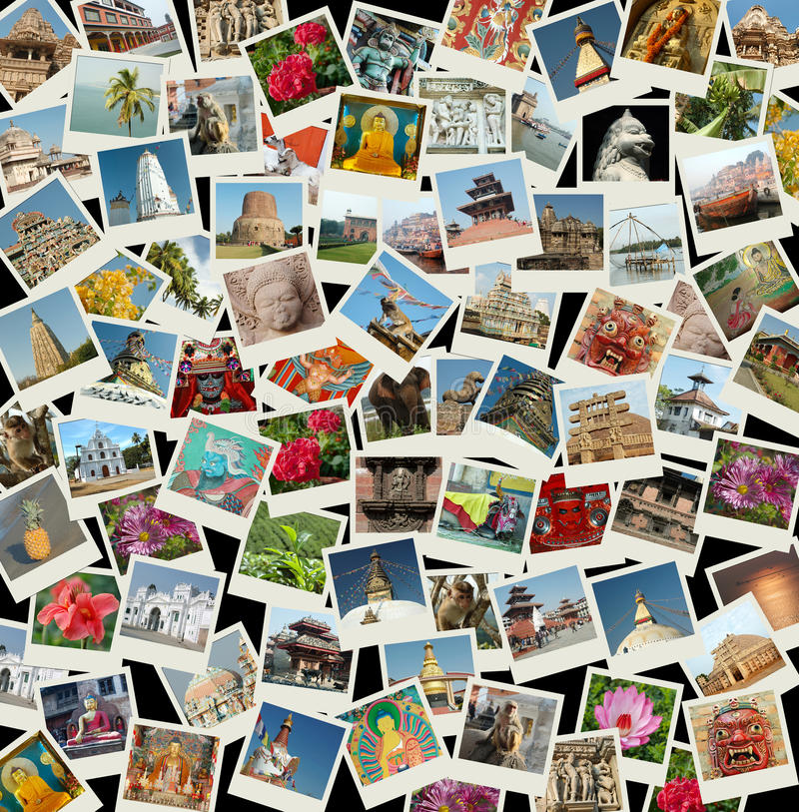

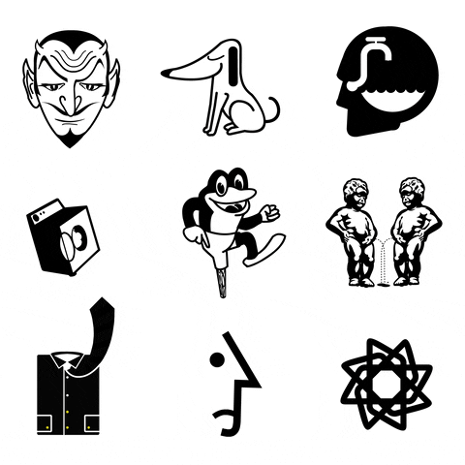

Understanding
Identify what your AI needs to be explicitly taught so it can understand your domain.
We will require:
- Good quality images
- Sufficient images ( ~600 each)
- Link to Wikipedia for information
- Basic information of some local foods
Notes:
The team came to an agreement to work on both a chatbot and a visual recognition tool.
For visual recognition, even though the amount data is growing with time, only a fraction of it is usable through traditional analytics. As visual recognition utilizes neural networks to compare image patterns. Our AI will learn to recognize patterns in the fed image data and map these patterns to future outcomes. And in order to do so, the team will need a significant amount of images of decent quality in order to teach our AI to master image classification.
And for the chatbot, the team has also integrated Wikipedia as a source of information to provide some basic write up on the different local food.

Slide 15

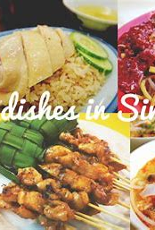
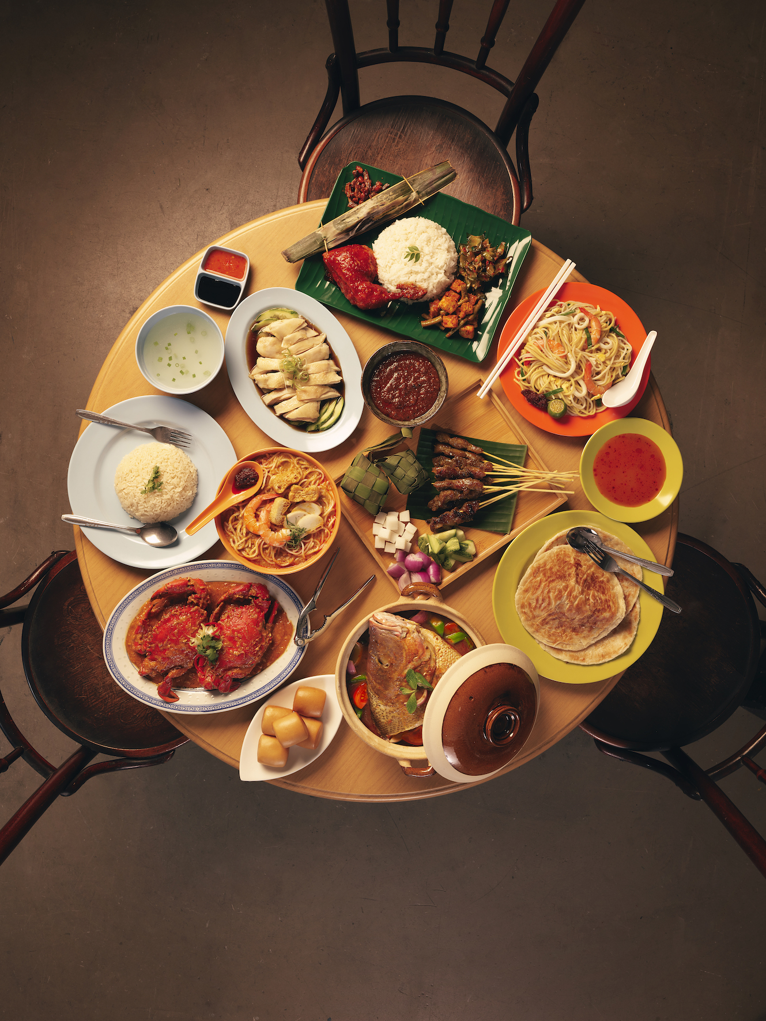
Data and Policy
All of the significant raw data a machine can collect from the user and the world and the policies that protect it.
Data We Need
For example:
Images of specific food
Where users are from,
What specific foods they are looking for,
What are the main types of questions,
Where and when they ask these questions
Data We Need for future improvements
Compatibility with other languages
Additional Food recommendations based on time
Location of available foods
Data Protection
PDPA
Notes:
For data and policy wise, the team sourced raw data from over the internet, most of them were image contributions from food bloggers in Asia. We needed data on images of specific food, where the users are from, what do they usually look for and even where and when they ask these questions. All these can be derived from google images as well as google trends.
For future development, since our target users are mainly foreigners, it would make more sense for the app to be available in different languages. The team would also be looking into integrating food recommendations and location mapping as additional features of our system.
Lastly, for security and data privacy the team understands that there may be certain users who are concerned about their personal data. The data collected will be used in line with the Personal Data Protection Act (PDPA)

Slide 16

Reasoning
Revisit your big ideas to augment, refine and tighten them based on your data and understanding exercise work.
Makan Ventures can help to:
Showcase specific hawker foods from 3 main ethnicities in Singapore
For food where the chatbot has not been trained, link to Wikipedia is used
Process uploaded images of food using image recognition, provide users with the name of food
Notes:
The team came up with the name Makan Ventures for our project, it showcase hawker food from the 3 main ethnic groups in Singapore, Chinese, Malay, Indian. And for food that are not from the registry, Makan Ventures will direct them to Wikipedia.
It will also process uploaded images of food and generate a response by providing the name of the food with the closest match.
Once there is enough data on the system, the AI will be able to look at the patterns in user requests and generate a better result for the users. For example, the top 3 foods in each ethnicity.

Slide 17


Knowledge
This is what the system knows. This is all past data, insights, and learned attributes measured up against the overall intent of the system.
Primary
Provide users with information on local food
Provide food name based on images
Secondary
Greater interest in local food
More exposure of hawker culture in Singapore
Tertiary
Un-intended biases
Inaccurate results
Notes:
The primary objective of our system is to provide users with information on local food and to provide food names based on images. The secondary intent would be to rally greater interest in our local food as well as provide more exposure of hawker culture in Singapore. Lastly, the tertiary group we have un-intended biases and inaccurate results. These would be the stuff the team would keep in mind as they may lead to negative feedback.

Slide 18
Project planning and design
Notes:
Next let us dive into the planning and design journey of the project.

Slide 19
Project Planning & Timeline
21 Jan.
brainstorming + mural plotting + Start chatbot development
24 Jan.
mural discussions
25 Jan.
Chatbot completion
25 Jan.
Start on Kaggle to develop AI classification program
mid-point discussion
1–2 Feb.
go CNY crazy
10 Feb.
final project review and discussion
11 Feb.
final project submission and Presentation
28 Jan.
8 Feb
Complete AI classification program
9-10 Feb.
Integration & Deployment
Notes:
The team initiated the project on the 21st of Jan, we adopted mural as our channel of collaboration and started the chatbot development. The chatbot was completed on the 25th.
Subsequently, the team moved on to develop the AI classification program on Kaggle and got it up and running on the 8th of February.
After some fine tuning, the project went into full deployment on the 10th of Feb.

Slide 20
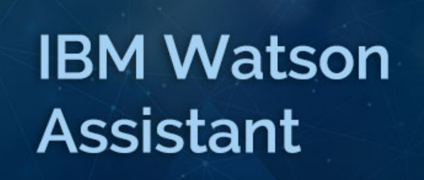



Implementation Overview
Chatbot
(Embed --> Web)
Project File Repository
H5 (model)
Flask app
Web app (e.g. html/chatbot script)
Procfile
Requirements.txt
Host (make available to Public users)
www.appname.herokuapp.com
Deploy
- Images - Python Codes - Model(h5)
Notes:
For implementation wise, the team used IBM Watson Assistant to build the chatbot and Kaggle for development of the CNN model using python. All the training, validation and testing images are also stored in Kaggle. Flask was also used as a web framework to develop the web application.
The team used GitHub as our project file repository to store all the source codes for deployment to
Heroku. and Heroku was used to host our web application.
There will be a more detailed elaboration on how made use of the various platforms for Makan Ventures further on in the presentation. Next I would pass on the mic to Lee Sim, where she will take you through the chatbot development process.

Slide 21
THE BOT!
Notes:
1. The Bot
As the technology continues to advanced, we leverage IA chatbot continue to emerge. We used Watson Assistant to build our chatbot framework, which is called Makan Bot. Makan bot handles greeting, Wikipedia search, main meal and dessert enquiry, food order and ending intents.
AI chatbot help to take our user experience to the next level. Our AI chatbot can radically reduce response times and available 24/7 across the channel from webchat. We able to improve our user experience through prompt and effective responses. It’s also possible to reduce our overhead and increase our conversion rate through chatbot.

Slide 22
Chatbot Dialog Flow
Welcome (Home Page)
Mains
Chinese
Indian
Dessert
-
Malay
Chicken Rice
Chilli Crab
Char Kway Teow
Roti Prata
Nasi Briyani
Thosai
Rendang
Satay
Nasi Lemak
Cheng Tng
Cendol
Tell me About (Search/Webhook)
Order / Back to Home Page / Anything Else
Notes:
2. Chatbot dialog flow
A dialog defines the flow of our conversation in the form of a logic tree. It matches intents to responses. Each node of the tree has a condition that triggers it, based on user input. Let me walk through the dialog flow with you all. Once user clicks on the virtual assistant icon on the bottom right of our website, it will prompt to the user with a welcome page. It is easy to recognize content by clicking “I am looking for main meal” or “I am looking for dessert”. Once user click on “I am looking for main meal”, system will prompt with the options “Chinese”, “Indian” and “Malay”. To choose either one, just click on the option, system will prompt with the list of local food choice based on the ethnic group they choose. The system will prompt with the list of information and picture of chicken rice, chili crab and Char Kway Toew for Chinese food, Roti Prata, Nasi Biryani and Thosai for Indian food, Nasi lemak, Rendang and Satay for Malay food. System also list down the information and picture for our local dessert of Cheng Tng and Cendol. For our project purpose, we just input on few food choice and will add more food choice for future enhancement.
We have connected Watson Assistant with Wikipedia to help user to identify local food by key in the name of the food they want to search for and system will return the list of information with a picture.

Slide 23
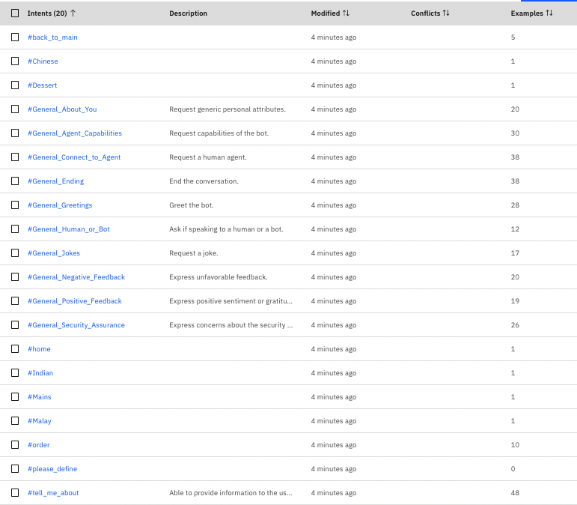
Intents for dialog
General Greeting
Tell Me About
Mains or Dessert
Chinese, Indian, Malay
Back to Main
General Ending, Order
Please define
General (Agent Capabilities etc.)
Notes:
3. Intents for Dialog
An intent is a collection of user statements that have the same meaning. By creating intents, we train our assistant to understand the variety of ways users express a goal.
We have added in some user examples such as general greeting, tell me about, mains or dessert, Chinese, Indian and Malay, back to main, please define, general ending, order and etc. that what user might say to make it easier to identify new phrasing for our intents.

Slide 24
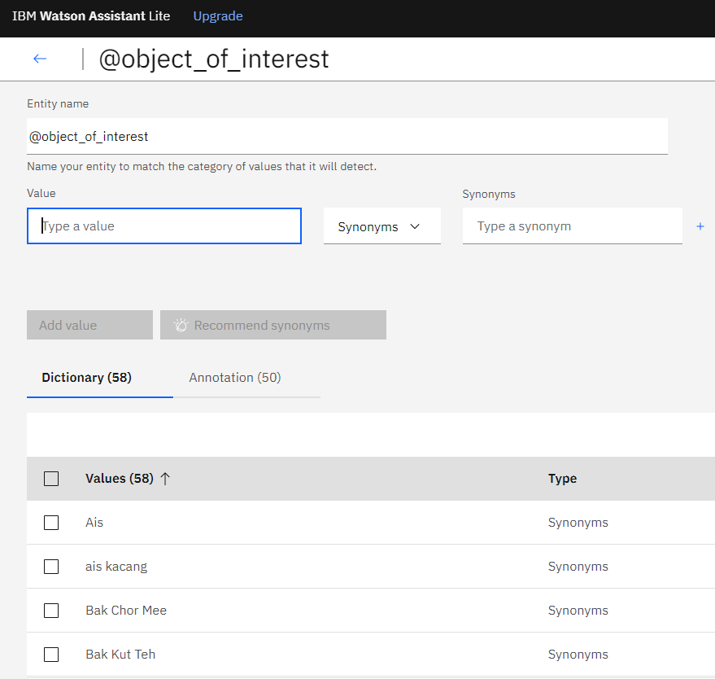
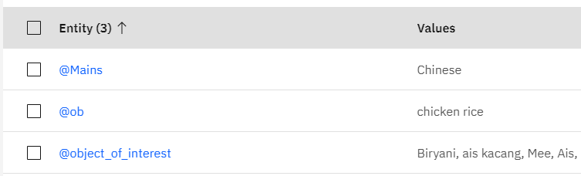
ENTITIES for dialog
Notes:
4. Entities for Dialog
An entity represents a term or object that provides context for an intent, such as entity Object of Interest that help our dialog to distinguish what food the user is interested.

Slide 25
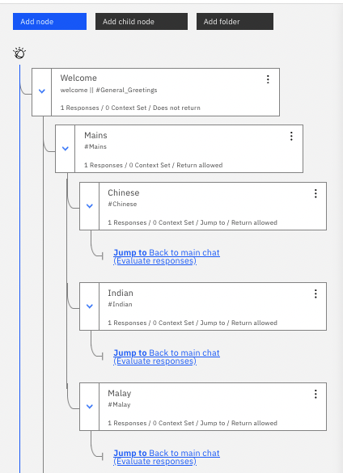
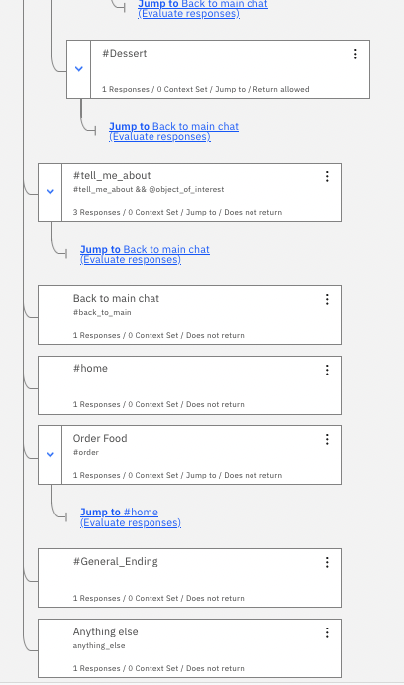
Dialog nodes
Notes:
5. Dialog nodes
Dialog nodes offers a set of full-feature editors that we use to define both our training data and the conversation, with greater control over the logical flow.
The dialog is processed by our assistant from the first node in the tree to the last. As it travel down the tree, if our assistant finds a condition that is met, it triggers that node, it then move along the triggered node to check the user input against any child node conditions. As it checks the child nodes it moves again from the first child node to the last.
Welcome node is the first node contains a greeting to our users when they first engaged with our assistant.
Anything else node is the final node that contains phrases that are used to reply to users when their input is searching for local food and the search result will be triggered from Wikipedia.

Slide 26
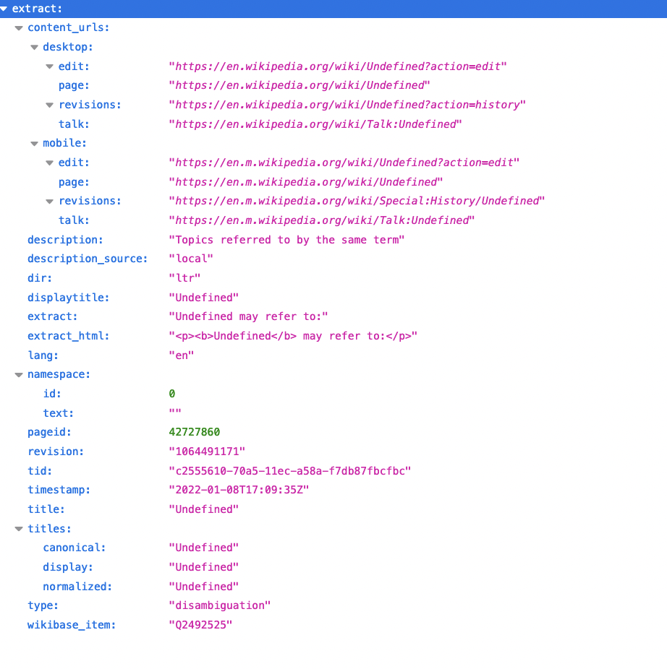
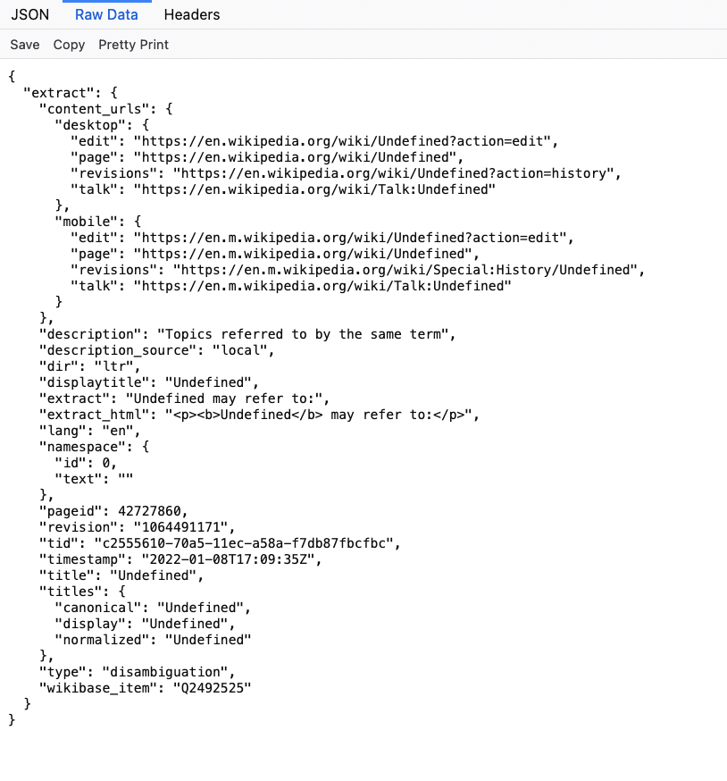
Webhook Call
Webhook on the ChatBot is used to answer "anything else"
The object of interest allows the user to ask general questions. The object is the "subject" of inquiry from Wikipedia
https://us-south.functions.appdomain.cloud/api/v1/web/b4db7b37-c186-4324-8940-16c506bab8b6/package%20function/Wiki2.json
Notes:
6. Webhook call
We built a chatbot that gives definitions not only a given set of entities, but also make external API callouts from Watson Assistant using Webhooks to get definitions for contextual entities from Wikipedia.
A Webhook is a mechanism that allow us to call out to an external program based on events in our dialog.
In the #tell_me_about node, if assistant recognize #tell_me_about and @object_of_interest, then will call out to my webhook, return key parameter of Object_of_interest.

Slide 27
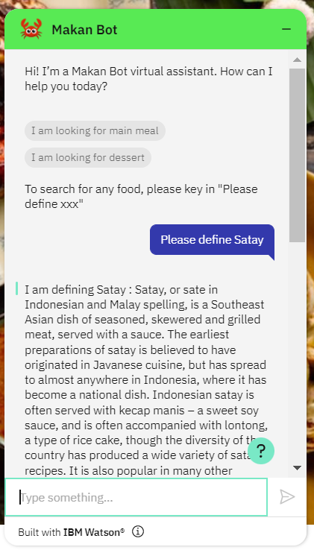
WIKIPEDIA INTEGRATION
Integration with Wikipedia
Notes:
7. Wikipedia Integration
Our Makan bot is an AI based reference librarian that can understand what the users asking for and return with the search result from Wikipedia. User can keep it as their own personal encyclopedia.

Slide 28
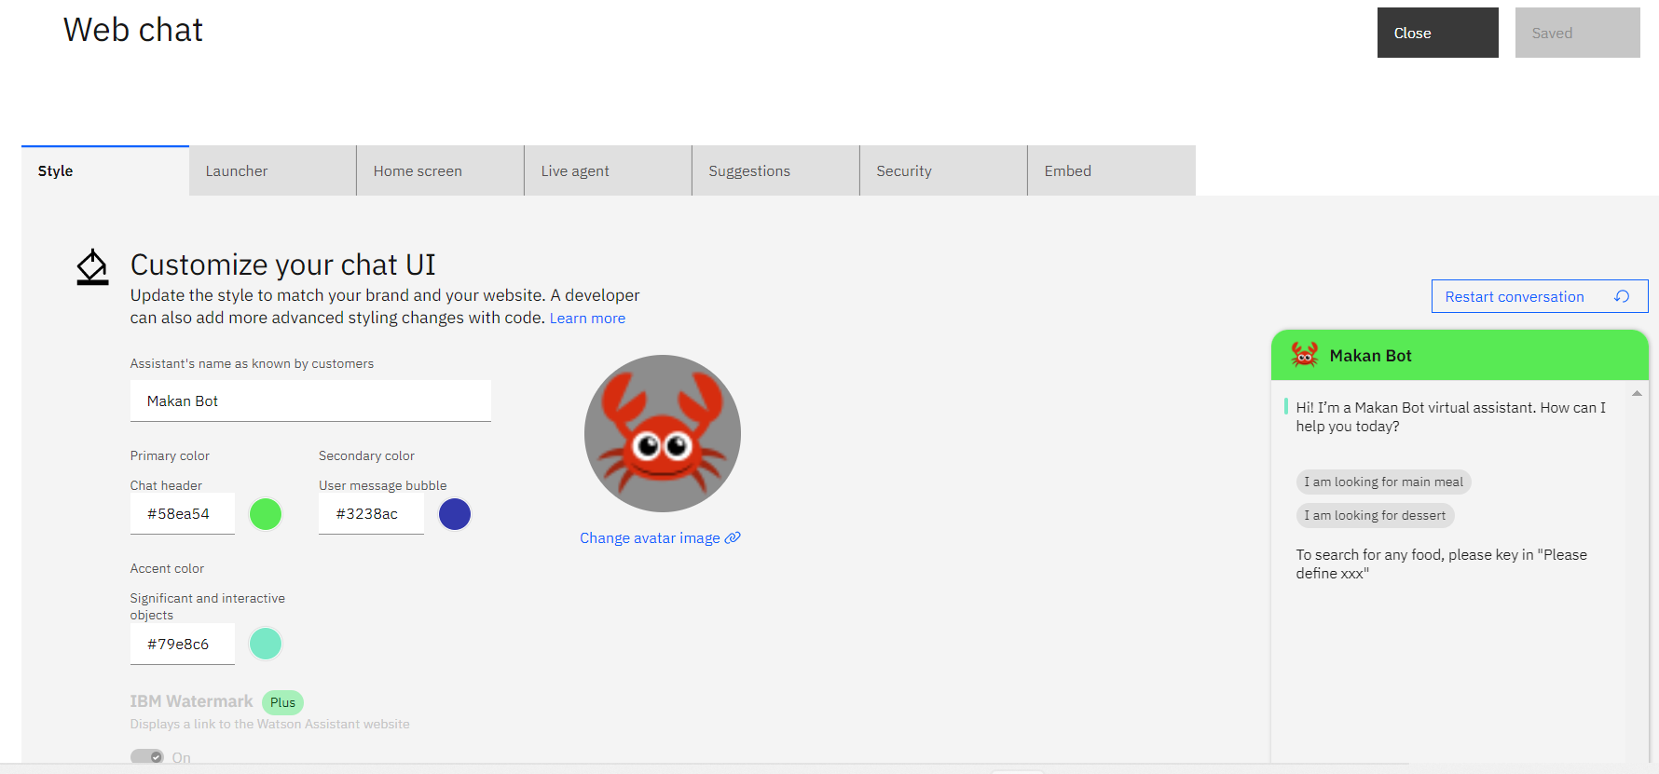
Customize chat user interface
Notes:
8. Customize our Chat User Interface
We have updated the AI chatbot style to match our brand and our website.

Slide 29
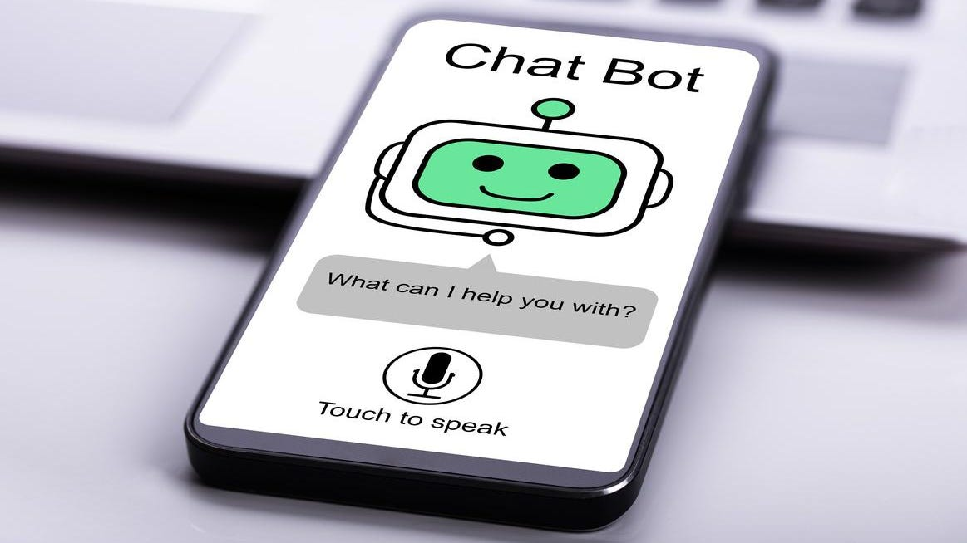
Embed chat bot in website
Embed the below javascript (chat bot) into the html page
<script>
window.watsonAssistantChatOptions = {
integrationID: "b62c7c70-4235-4a15-b729-00f5b4af66d4", // The ID of this integration.
region: "eu-de", // The region your integration is hosted in.
serviceInstanceID: "debb6380-d869-4d59-9145-54157b53aa0a", // The ID of your service instance.
onLoad: function(instance) { instance.render(); }
};
setTimeout(function(){
const t=document.createElement('script');
t.src="https://web-chat.global.assistant.watson.appdomain.cloud/versions/" + (window.watsonAssistantChatOptions.clientVersion || 'latest') + "/WatsonAssistantChatEntry.js"
document.head.appendChild(t);
});
</script>
Notes:
9. Embedded chatbot in website
Select Webchat and open the Get Embed Code tab. These are the embedded code that added in our website. The web chat configuration options are defined by the parameters of Watson Assistant Chat Options. By default, the embed code provided by Watson Assistant configured only the integration ID, Serviced Instance ID, and the region parameters. These options also include a onLoad callback that will be called when the web chat has been loaded and a new instance has been created.

Slide 30
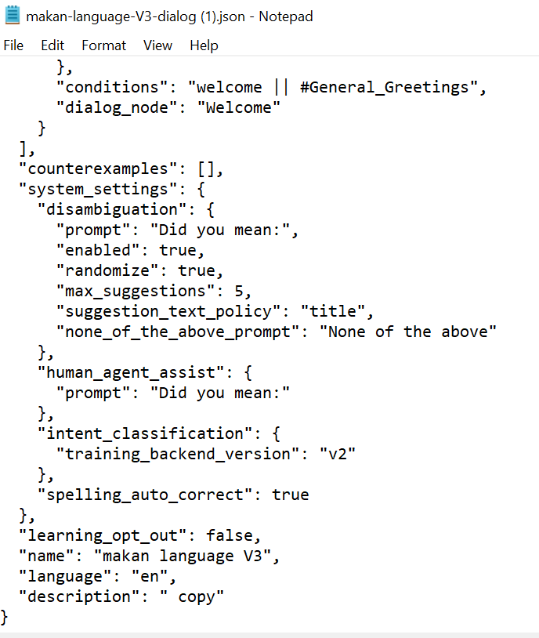

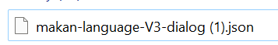
Json file
Notes:
10. Json file
Once we have created our chatbot, we save a copy of Json file and share among with each team members. JSON stands for JavaScript Object Notation. It is a lightweight data-interchange format and can be easily be sent between computers, and used by any programming language.

Slide 31
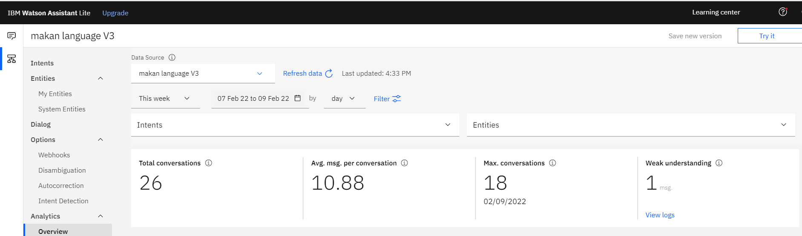
Analytics overview
The total number of conversations between active users and our application during the selected time period.
Average messages per conversation is the total messages received during the selected date range divided by the total conversations during the selected date range.
Max conversation is the maximum number of conversation that took place during a single time interval within the selected date range.
Notes:
11. Analytics overview
The analytics page of Watson Assistant provides a history of conversations between users and a deployed assistant. We can use this history to improve our assistant understand and respond to user requests.

Slide 32
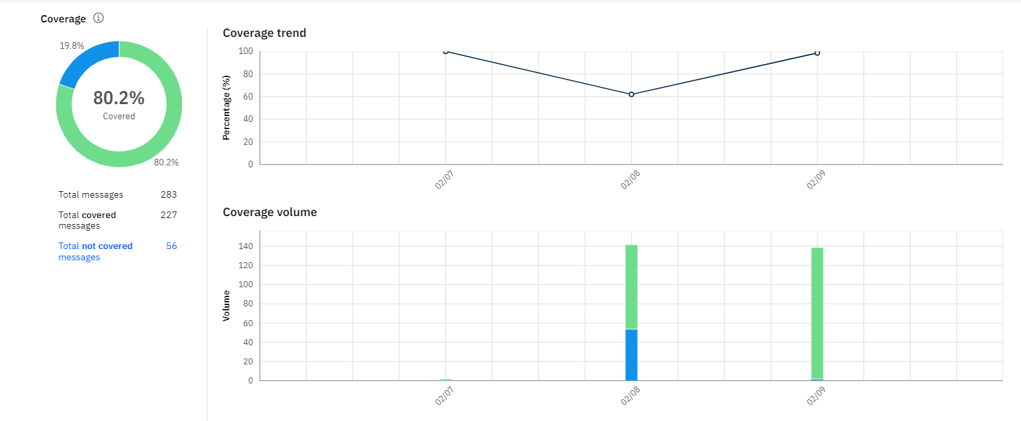
Analytics (coverage)
The rate at which our Makan Bot is confident that it can address the user's request per message.
Notes:
12. Analytics (coverage)
This is the chart showing the coverage trend and coverage volume and the rate at which our Makan Bot is confident that it can address the user's request per message.
Based on the analytics,
total messages were 330
Total covered messages 265
Total not covered messages 65
With the rate of 80.2% message covered.

Slide 33
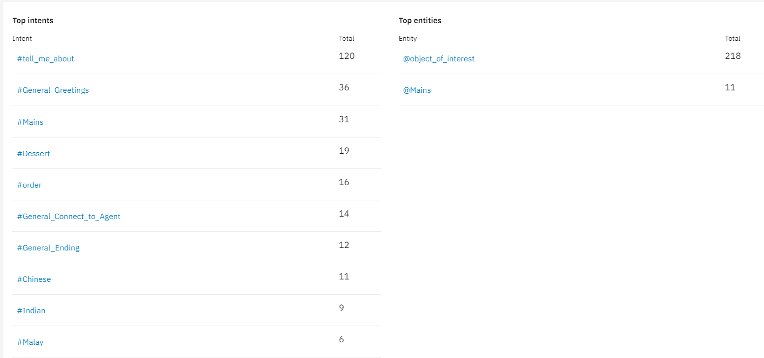
Analytics (Top intent/ entity)
Highest intent
Highest entity
Notes:
13. Analytics (Top intent/ entity)
Watson can analyze our logs and compare its findings with our intents. Based on what it learns, the highest intent is #tell_me_about and the highest entity is @object_of_interest. Watson can identify gaps in our training data and suggest new intents to fill them.

Slide 34
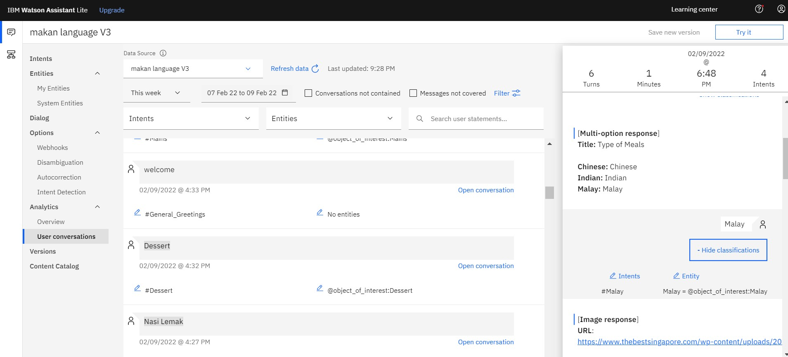
Analytics (conversation)
Conversation
Notes:
14. Analytics (Conversation)
We can view individual messages, filter messages by Search user statements, Intents, Entities, and Last n days.
For any user input entry, click Open conversation to see the user input and the response made to it by the assistant within the context of the full conversation.
The time that is shown for each conversation is localized reflected the time zone of our browser.
From the User conversation page, we can analyze actual interactions between the assistant we used to deploy the skill and our users. Based on those interactions, we can make corrections to improve the accuracy with which intents and entities are recognized by our dialog skill. It is difficult to know exactly how our users will ask questions, or what random messages they might submit, so it is important for us to analyze real conversation frequently to improve our dialog skills.

Slide 35
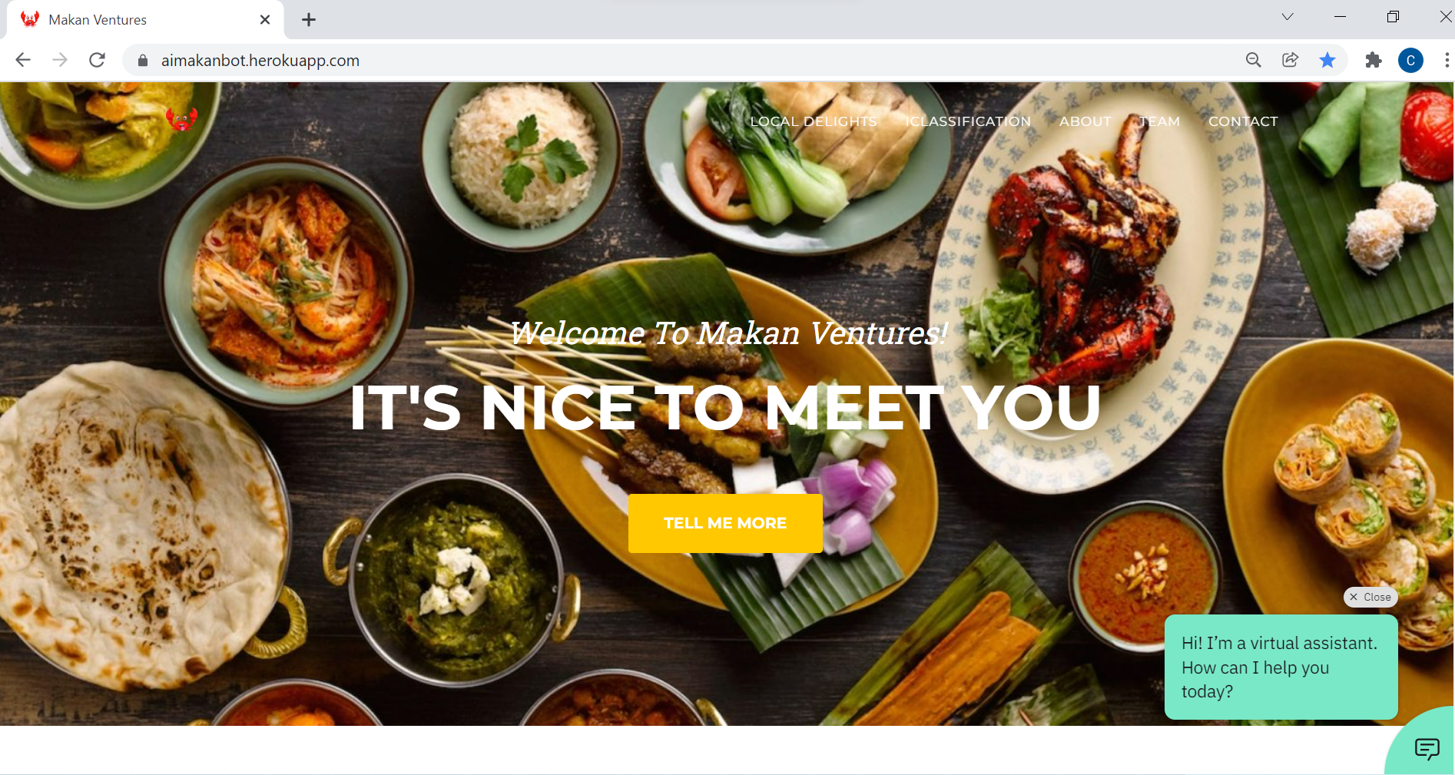
Embedded chatbot in website
Notes:
15. Embedded Chatbot in website
Here you go, our AI chatbot is ready on a website. Once aimakanbot.herokuapp.com website is loaded, on the bottom right corner will prompt with a message “Hi! I’m a virtual assistant. How can I help you today?”.

Slide 36
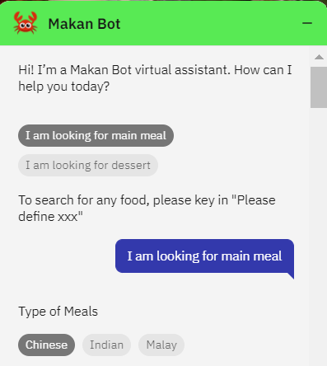

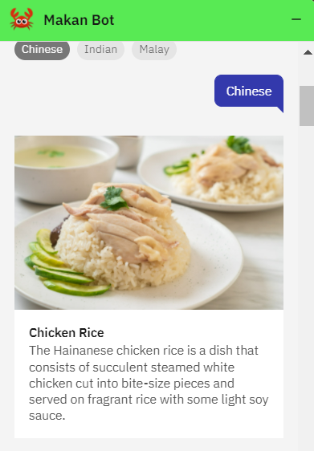
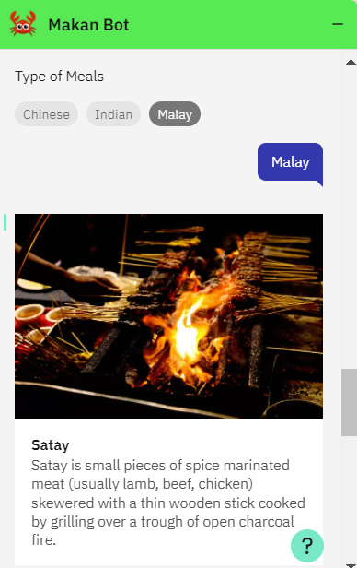
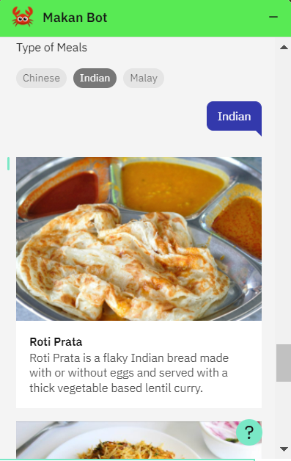

Dialog (Main meal)
Notes:
16. Dialog (Main meal)
Once the user clicks on “I am looking for main meal”, it will prompt with the options of Chinese, Indian and Malay. Our Makan bot will display a list of food information with picture once user click on the types of meal. On the left panel is displaying Chinese food, middle panel is displaying Malay food and right panel is displaying Indian food.

Slide 37
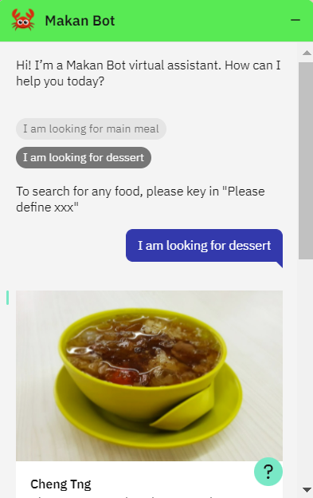
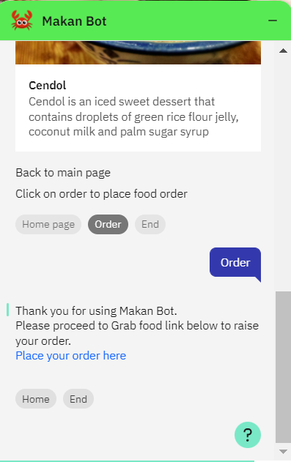
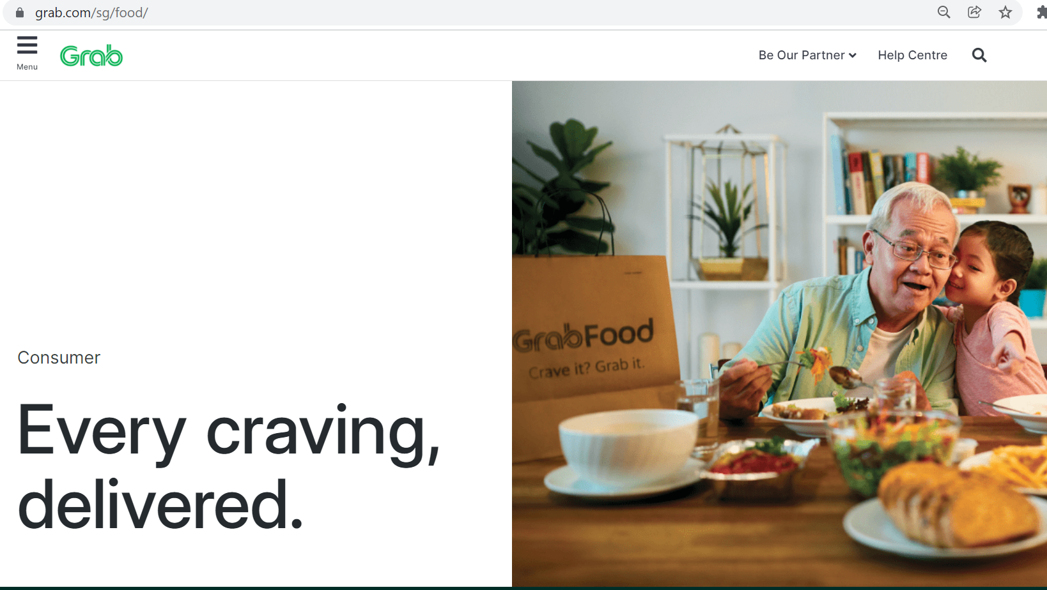

Dialog (Food order)
Notes:
17. Dialog (Food order)
We also have have the option of dessert. User can place the order by clicking on Order, it will prompt with a link of Grab food.

Slide 38
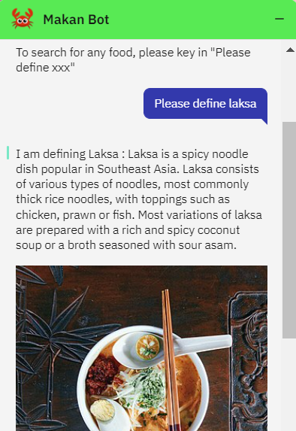
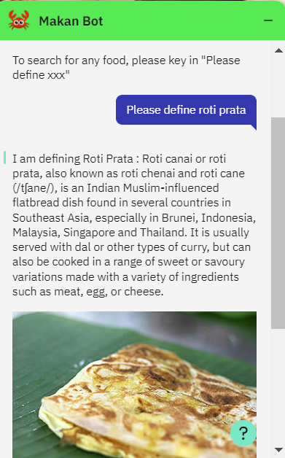
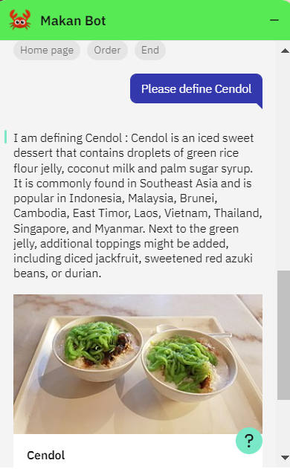
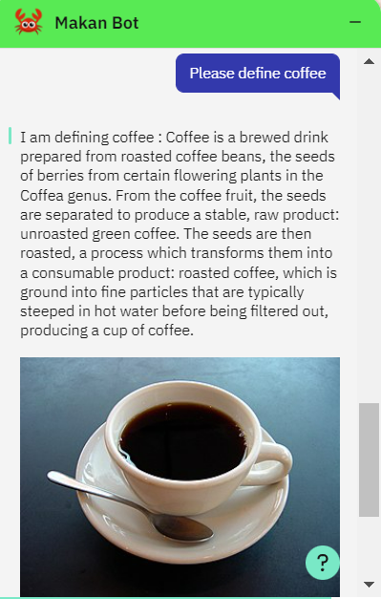
Wikipedia search
Notes:
18. Dialog (Wikipedia Search)
These are the example of our Wikipedia Search result from Makan Bot such as Laksa, Roti Prata, Cendol and Coffee.

Slide 39
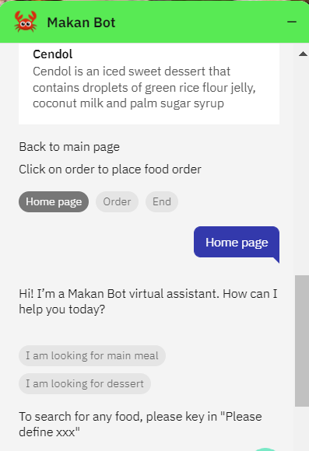
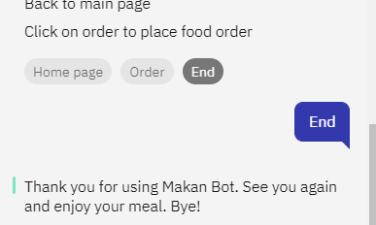
Dialog (Back to main/ End)
Notes:
19. Dialog (Back to main/ End)
By end of each conversation, our Makan bot giving the option for user go back to main page, order the food and end the conversation.
To extend the user experience, we created an Image classification and now I will hand it over to Yoke Fuan to run through the steps. Hand over to you, Yoke Fuan. Thank you.

Slide 40
AI classification (image classification)
Notes:
Thanks Lee Sim for sharing on the development of the Chat Bot. I will be sharing with you our solution for AI Classification which is the portion on image classification.

Slide 41
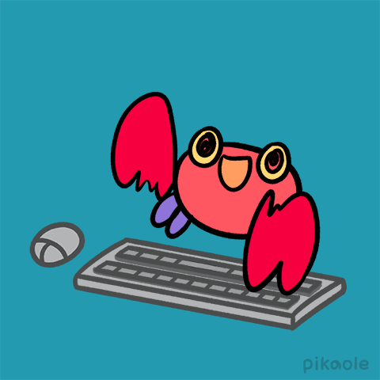
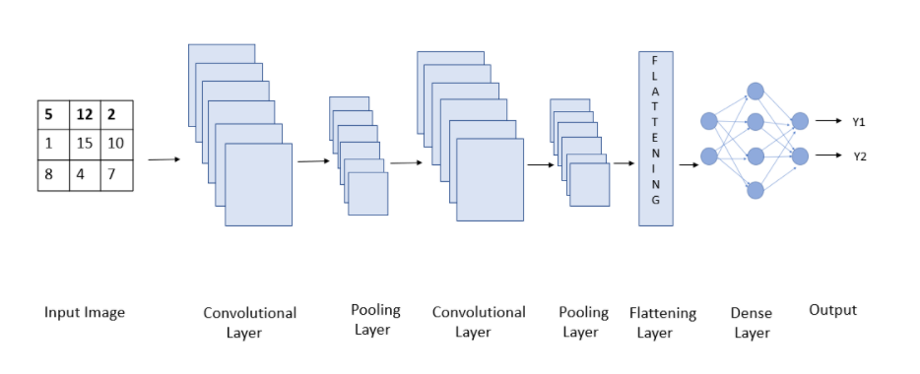
Ai classification (image classification)
Convolutional Neural Network (CNN) model​ -> 3 categories of local food
Feature Extraction
Classification
Notes:
For image classification, we are adopting the Convolutional Neural Network (CNN) model to predict the different categories of Singapore Local Food. Due to time constraint
we will be focusing on 3 categories of local food which are namely Chicken Rice, Hokkien Prawn Noodles and Ice Kacang.
A CNN model works in three stages. In the first stage, a convolutional layer extracts the features of the image/data.
In the second stage a pooling layer reduces the dimensionality of the image, so small changes do not create a big change on the model. This is to prevent over-fitting.
In the third stage a flattening layer transforms our model in one-dimension and feeds it to the fully connected dense layer. This dense layer then performs prediction of image. A good model should have multiple layers of convolutional layers and pooling layers.
From the diagram, we can see that from the input image to the pooling layer, we are doing feature extraction, from the flattening layer to output, we are doing classification.

Slide 42

Ai classification (image classification)
Steps:
1. Import all the libraries needed
2. Read in images as input. Reduce the size of images to 32X32. Rescale the image size to be between 0 to 1.
3. Build the Convolutional Neural Network (CNN) model
4. Compile the model
5. Train the model
6. Visualization the model accuracy and loss
7. Evaluate model accuracy
8. Save the model
9. Test the model
Notes:
For this slide, this is all the steps that are performed within the program for image classification.
Step 1: Import all the libraries needed
Step 2: Read in images as input and reduce the size of the images to lower resolution of
32 by 32 and rescale the image size to be between 0 to 1.
Step 3: Build the Convolutional Neural Network (CNN) model
Step 4: Compile the model
Step 5: Train the model
Step 6: Visualise the model accuracy and loss
Step 7: Evaluate the model accuracy
Step 8: Save the model
Step 9: Test the model
For the subsequent slides, I will walk through with you the exact snippet of the source codes for each of the steps.

Slide 43


ai classification – Step 1
Step 1: Import all the libraries needed
Libraries:
- Tensor Flow
- Keras
- Matplotlib
Notes:
For Step 1, we will import all the libraries needed.
The left side screenshot shows the source codes.
The libraries which we are using is tensorflow, keras and matplotlib.

Slide 44




ai classification – Step 2
Step 2: Read in images as input. Reduce the size of images to 32X32. Rescale the image size to be between 0 to 1.
Training Dataset
Validation Dataset
Test Dataset
Notes:
For Step 2, we read in the images from a particular directory, reduce the size of the images to 32 by 32, rescale the image size to be between 0 to 1.
We have 3 sets of data, one for training, one for validation and one for testing. The validation data set is not used for the training, it is only used to
evaluate the accuracy of the model. The testing data set is used for testing the accuracy of the prediction.
On the right side of the source codes, it shows the structure of the directories for training, validation and testing.

Slide 45

ai classification – Step 3
Step 3: Build the Convolutional Neural Network (CNN) model
Sequential API – Layered model
Conv2D – used for images
Kernel – Filter which will move through the image and extract the features
ReLu – Rectified Linear Unit – Most famous activation function for deep learning
MaxPooling2D – Reduce image size and keep important features
Dropout layer – Prevent overfitting
Flattening layer – converts 3d image to 1d
Dense layer – Fully connected layer, feeds all output from previous functions to all neurons. Does the work of training the model. Units shows the neurons model is going to use.
Softmax – Multi-class classification
Notes:
For Step 3, we will build the CNN model.
Sequential API allows us to create a layered model and add it to the sequential Class.
Conv2D is generally used for images. Kernel means a filter which will move through the image and extract features of the part using a dot product.
ReLu function: It is the abbreviation of Rectified Linear Unit. It is the most famous activation function for deep learning. It is famous because it is easier to compute
since the mathematical function is easier and simpler than other activation functions.
For MaxPooling2D: Pooling layer is used to reduce the size of the image along with keeping the important parameters in role. Max Pooling is to narrow down
the scope of all the features, so that only the most important features are taken into account.
A dropout layer is added to prevent overfitting.
Flattening Layer is added after the stack of convolutional layers and pooling layers. Flattening layer converts the 3d image vector into 1dimension as the Dense layer requires the
data to be passed in 1 dimension.
Dense layer is a fully connected layer and feeds all output from the previous functions to all the neurons. Dense layer has a weight W, a bias of B and the activation
which is passed to each element. It connects all the dots. This layer uses all the features extracted before and does the work of training the model. The units shows the
number of neurons the model is going to use.
Softmax is used for multi-class classification.

Slide 46
ai classification – Step 4
Step 4: Compile the model
categorical_crossentropy – multi-class classification
Learning rate – 0.001
Notes:
For Step 4, we will compile the model.
We use categorical_crossentropy as we are doing multi-class classification.
The learning rate is 0.001.

Slide 47




ai classification– Step 5
Epochs = 25
As epochs
Model loss
Model accuracy
Step 5: Train the model
Notes:
For Step 5, we will train the model using 25 Epochs.
For the training and validation dataset, as the epoch increases, the model loss decreases,
model accuracy increases, this will be depicted in graph format in the next slides.

Slide 48


ai classification – Step 5
Step 5: Train the model
Notes:
This slide shows the results of the model summary.
The summary includes information about:
The layers and their order in the model.
The output shape of each layer.
The number of parameters (weights) in each layer.
The total number of parameters (weights) in the model.

Slide 49



ai classification – Step 6
Epochs = 25
As epochs
Model accuracy
Model loss
Step 6: Visualization the model accuracy and loss
Notes:
For step 6, after training the model, we visualise the model accuracy and loss.
From the graph, it is observed that for training and validation dataset, as epochs increases,
the model accuracy increases, model loss decreases.

Slide 50


ai classification – Step 7 & 8
Step 7: Evaluate the model accuracy
Test Dataset
90% prediction accuracy
Step 8: Save the model
Save the model to predict the local food in website.
Notes:
For step 7, we use the testing dataset to evaluate the model accuracy.
It has a prediction accuracy of 90%.
Step 8, we will save the model so that we can use this .h5 model file to predict the local food in the website.

Slide 51





ai classification – Step 9
Step 9: Test the model
Notes:
For step 9 which is the last step for the program, we proceed to test out the model using some testing
images which are not inside the training and validation dataset.
For the next slide, I will be sharing the summary of the data that we have used.

Slide 52



ai classification - DATA
3 Categories of Singapore local food:
 | Chicken Rice | Hokkien Prawn Noodles | Ice Kacang
Training Images | 805 | 610 | 493
Validation Images | 40 | 31 | 24
Data preparation
Tedious process, need to remove background for images
Crop and remove the unnecessary items so that training can focus on the correct item
Notes:
We have 3 categories of Singapore local food, which are chicken rice, hokkien prawn noodles and ice kacang.
We used 805 images for training for chicken rice, 610 for hokkien prawn noodles and 493 for ice kacang.
For validation, we used, 40 images for chicken rice, 31 images for hokkien prawn noodles and 24 for ice kacang. The number of validation images is about 5% of the training images.
On the slide itself, there are some samples of the training images that we have used.
For data preparation, prior to the training of the model, there is a need to remove the background for most of the images, and some of the images needs to be cropped to remove the unnecessary
items so that the training can be more accurate. For e.g, if the image contains chicken rice with a cup of tea, there is a need to remove the cup of tea from the image to improve the accuracy of the training for the model.
Recall that we have saved the CNN model in the previous slides. We will integrate the model into the website which I will explain in more details in the next slide.

Slide 53
Integrate model into website

Slide 54


integrate model into website
Python code at the web layer - app.py
4
5
6
1
7
2
8
3
Notes:
This slide shows the python code at the web layer which we will call the previously saved model
to do the prediction.
On the left hand side screenshot, for item 1, we will set tensorflow to run in cpu instead of gpu.
Item 2, we load the model from the .h5 file.
Item 3, At the default main page, we will save the file which is uploaded for prediction.
On the right hand side screenshot, after the file is uploaded, it will be redirected for prediction.
Item 4, Step 1, we will read the uploaded image file for prediction.
Item 5, Step 2, we have to resize the image to 32 by 32.
Item 6, Step 3, we will do the prediction for the uploaded image.
Item 7, Step 4, we will sort the prediction so that we can get the prediction with the highest probability.
Item 8, Step 5, we will return the prediction and saved file location to the predict.html page so that it
can be displayed at the html page.
I have completed the sharing on the source codes for Image Classification.
Next, I will be sharing on the integration and technical architecture.

Slide 55
Integration/technicaL architecture

Slide 56









Integration/technical architecture
IBM Cloud
Website (Flask App)
Webhook
Browser
User
Deploy
(Repository)
(.h5 model)
Developer
Notes:
For the technical architecture, the user will make use of the browser to access the website which is
hosted on heroku. Heroku is basically hosted on AWS. When the user access the chatbot on the website,
it is actually accessing IBM Watson Assistant on IBM cloud. We have a webhook call to wikipedia. This is
to do a search for information on Singapore local food via wikipedia. Wikpedia will return us the search
results.
We make use of GitHub as a repository to store all our source codes which we have developed using
kaggle. The h5 model for prediction is developed using Keras.
During deployment, the source codes will be pulled from GitHub to Heroku.
The web application is developed using Flask. Flask is a micro Python web framework
that provides useful tools and features that makes creating web applications in python easier
which is suitable for development of our MVP.
Next, I will share more on the integration and deployment.

Slide 57





Integration and deployment
GitHub
(Repository)
Website
Developer
Check-in Source Codes
Pulls all the source codes
GitHub Files / Folders
Deployment
Notes:
For integration and deployment, developer will check-in the source codes into GitHub which is
our repository. During deployment in heroku, we will connect to GitHub so that we can pull the source
codes for deployment.
I have completed my sharing on Image classification and integration/technical architecture.
I will hand over to Sebastian who will be sharing on the live demo and project learnings.

Slide 58
LIVE DEMO

Slide 59

Links
https://aimakanbot.herokuapp.com/

Slide 60

Orchard MRT

Slide 61
Project Learnings

Slide 62


Constraints & Challenges
Training requires tons of images
Equal/near representation to reduce bias.
Unsure of optimum number of images for good prediction.
Process of labeling the data set takes time.
Refining image e.g. remove background.
In the Chatbot, "Anything Else" option has to be the last node.
Additional code required to make it non-case sensitive e.g. Prawn Noodle vs prawn noodle. But in some cases, some still don't work e.g. Dosa vs dosa
GitHub limitation (25MB/file)
Heroku limitation (500MB)
Obtaining prediction accuracy by trial and error in no. of EPOCHS.
Notes:
Now allow me to go through the challenges and constraints our team faced while working on this project.
Firstly, we learnt that training the machine really requires aloooot of images. For starters, we were able to obtain 800+ pictures for Chicken Rice from Kaggle. But that is the furthest we can stretch our good fortune. We had to source for the other images online where we managed to source 600+ for Hokkien Prawn Noddles and 490+ for Ice Kacang. We tried to keep the quantity as close as we can to avoid biasness towards certain category. We ran the model many times to try to get a feel of the optimum number of pictures required to train the model.
This brings us to the 4th and 5th point.
After the images were sourced, we went through a round labelling them and selecting them. Images with too many “interruptions” around the object of focus were rejected.
While working on the chatbot, we encountered in-consistencies while trying out the chatbot. Only after consultation with Su, we found out the “anything else” had to be the LAST node, which initially we put it 2nd last. We found out that the search to Wikipedia is at times case sensitive e.g. Dosa and dosa. We had to input additional codes to reduce this tendency.
And like all of us, we wanted to improve the accuracy of the prediction if we had the luxury of more space, however we are limited by Github’s 25MB/file and Heroku’s 500MB. We can only try to improve the prediction accuracy by trial and error in the number of EPOCHS.

Slide 63


Takeaways
Learning about the different models for deep learning is not enough to showcase AI, we still need know about front end (flask app) to showcase this to stakeholders.
The Volume and the Variety of images that are used for training greatly affects the accuracy of the prediction.
Teamwork is the essence to the success to any project.
Communication is key, even it is to disagree.
Show appreciation for the work done by members.
Time and patience is a virtue.
Notes:
So now, coming to the end of the presentation, our team learnt that learning of deep learning is not enough to showcase AI. To complete the whole picture, we will still need a front end MVP to showcase to the stakeholders.
Volume and Variety are key in affecting the accuracy of the prediction.
And most importantly, we wouldn’t be able to have this amazing presentation and MVP, without the excellent teamwork we had while working thru this project.
We learnt that communication is important, even if it is to disagree. As each member has our own part to play, each with our individual strengths, we appreciate that we had each other in the team, working towards a common goal. Gathering images, fine tuning them, working on the codes, requires immense patience and time. We can only be patiently working bit by bit to finally piece out the entire project.

Slide 64





Brought to you by the CRABS
Wong Yoke Fuan
Sebastian Ang
Lee Lee Sim
Saleem Jumabhoy
Tan Joo Hong
Notes:
We thank you for allowing us to share our project with you.

Slide 65

THANK YOU Any Questions?

Slide 66
supplementary Slides

Slide 67


ai classification - testing on website
Predict Chicken Rice:

Slide 68


ai classification - testing on website
Predict Hokkien Prawn Noodles:

Slide 69


ai classification - testing on website
Predict Ice Kacang:

